Slide 1
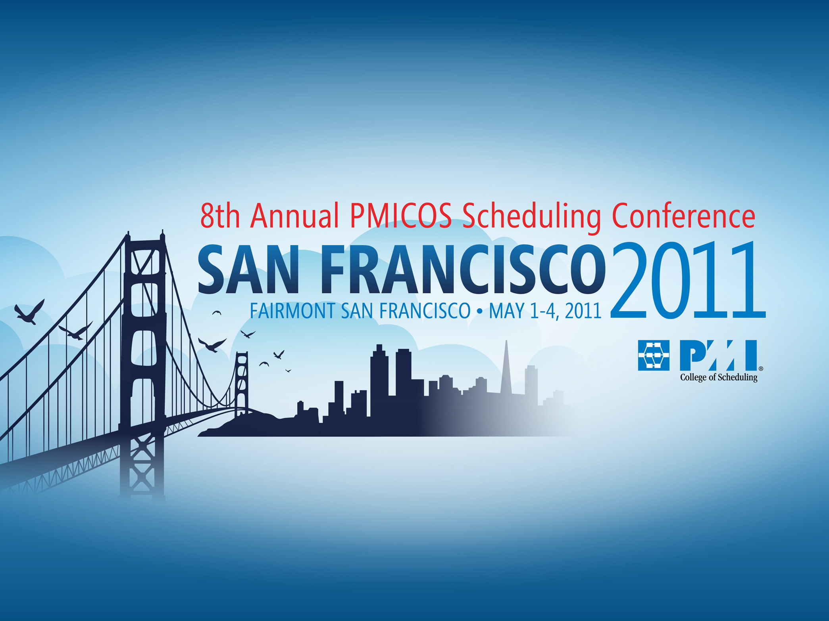

Slide 2
Use Of A Claims Triage Workshop
To Choose An Analysis Method
Chris Carson, PMP, PSP, CCM
Alpha Corporation
Corporate Director of Project Controls

Slide 3
Chris Carson, PSP, CCM, PMP
Corporate Director of Project Controls, Alpha Corporation
  Responsible for standards, processes, and procedures for a team of schedulers, analysts, and project managers in multiple office locations, as well as analysis, work product, and testimony
  Developed and manages the in-house project controls training program at Alpha
University: University of Virginia, Mechanical Engineering, 1972
Professional Field: 38 years of experience in Construction Management Services specializing in Scheduling, Schedule Analysis, Estimating, Claims
Active in PMI (Project Management Institute) College of Scheduling
  Vice President of Scheduling Excellence, Managing Director for SEI (Scheduling Excellence Initiative) writing Best Practices and Guidelines for Scheduling and Schedule Impact Analysis
Active in AACEi (Association for the Advancement of Cost Estimating International)
  Member of P&S and CDR Committees
  Author of Recommended Practices in Scheduling & Editor of Forensic Schedule Analysis RP
Active in Planning Planet
  Chief Editor for US, writing Planner Users’ Guide, developing accreditation Guild for planners
Active in CMAA (Construction Management Association of America)
  Served on committee revising Time Management Chapter of CMAA’s CM Standards of Practice
3

Slide 4
Co-Authors for Paper
Bob Kelly, PSP, CPE
  Director of Dispute Resolution, Alpha Corporation
  Co-Chairman of AACEi’s CDR Committee
Rob Kelly, Jr., PSP, PMP, CFCC
  Project Controls Manager Ohio, Alpha Corporation
  Acts as Neutral for Ohio School Facilities Commission

Slide 5
USE OF A CLAIMS TRIAGE WORKSHOP TO CHOOSE AN ANALYSIS METHOD
AACEI Recommended Practice 29R-03 “Forensic Schedule Analysis” properly notes that there are a number of factors to consider in choosing a method of analysis in a time-related dispute
The authors have developed a process that they have call a “Claims Triage” for use in evaluating every new dispute resolution assignment, organized and guided by a checklist and procedures.

Slide 6
USE OF A CLAIMS TRIAGE WORKSHOP TO CHOOSE AN ANALYSIS METHOD
Why have a Claims Triage to Choose an Analysis Method?
Variety of methods available – which is best?
Broad consideration from multiple participants with different experiences
Apply lessons learned
Training and mentoring
Choice of methodology is carefully considered and documented for use in the analysis, well before the analysis begins.

Slide 7
USE OF A CLAIMS TRIAGE WORKSHOP TO CHOOSE AN ANALYSIS METHOD
Claims Triage Process
Process involves a team approach
Commitment to RP 29R-03 Forensic Schedule Analysis, Section 5 “Choosing a Method” – Factors taken from this document
Team assignments based on experience
Importance of objective viewpoint during document management, review and analysis
Lead Consultant is assigned (often based on who receives the referral)

Slide 8
USE OF A CLAIMS TRIAGE WORKSHOP TO CHOOSE AN ANALYSIS METHOD
Information Needed for the Triage Session
Lead Consultant is responsible for coordination of triage meeting
Structure and conduct of the meeting is dependent on information developed prior to meeting
See Checklist A “First Meeting Interview with Dispute Resolution Client” for information necessary
  Project Facts
  Dispute Facts
  Legal Facts
  Source Documents and Data Validation
Engagement and Triage Information: chicken or the egg?

Slide 9
USE OF A CLAIMS TRIAGE WORKSHOP TO CHOOSE AN ANALYSIS METHOD
Information Needed for the Triage Session
Project Facts
  Parties/stakeholders
  Project type and description
  Project location
  Contract value
  Bid, start, completion dates
  Current project status – cost and schedule

Slide 10
USE OF A CLAIMS TRIAGE WORKSHOP TO CHOOSE AN ANALYSIS METHOD
Information Needed for the Triage Session
Dispute Facts
  An understanding of the dispute
  Size of the dispute
  Start of dispute
  Duration of the dispute
  Prior dispute communications
  Current dispute documentation/tracking efforts

Slide 11
USE OF A CLAIMS TRIAGE WORKSHOP TO CHOOSE AN ANALYSIS METHOD
Information Needed for the Triage Session
Legal Facts
  Litigation calendar
  Contract claims process
  Prior claim communications
  Current status of claim
  Any rebuttal arguments known at this time
  Any risks from counterclaims

Slide 12
USE OF A CLAIMS TRIAGE WORKSHOP TO CHOOSE AN ANALYSIS METHOD
Information Needed for the Triage Session
Source Documents and Data Validation
  Contract
  Plans and specifications
  Project baseline schedule
  Schedule update
  As-built information and accuracy
  Contemporaneous validation sources (daily field reports, time cards)
  Detailed bid estimate
  Job cost reports
  Requests for information
  Change orders
  Internal client analyses or reports

Slide 13
USE OF A CLAIMS TRIAGE WORKSHOP TO CHOOSE AN ANALYSIS METHOD
Information Needed for the Triage Session
Tasking and Budgeting
  Timeline for performance of the analysis
  Interim deliverables
  Budgetary constraints
  Methodology discussion
  Initial estimate of effort
  Client directive(s)

Slide 14
USE OF A CLAIMS TRIAGE WORKSHOP TO CHOOSE AN ANALYSIS METHOD
Expected Outcome from the Triage Session
Eliminate potential methodologies
Focused need on missing information
Better-performance of final methodology selection
Quality Control in process of methodology selection
Confidence in methodology selection

Slide 15
USE OF A CLAIMS TRIAGE WORKSHOP TO CHOOSE AN ANALYSIS METHOD
The Triage Session
Distribute information prior to Triage
  Documents acquired to date
  Summary of dispute
  Client-interview information
  Other “First Meeting Interview with the DR Client” information
The earlier the better
Well-briefed team = more effective Triage

Slide 16
USE OF A CLAIMS TRIAGE WORKSHOP TO CHOOSE AN ANALYSIS METHOD
The Triage Session
Review Project and Case Background
  Client overview
  Project summary
  Disputed issues summary
  Availability & legitimacy of baseline & updates
  Availability & legitimacy of documents

Slide 17
USE OF A CLAIMS TRIAGE WORKSHOP TO CHOOSE AN ANALYSIS METHOD
The Triage Session
Open Floor to Q&A from Triage team
  Information validation
  Identification of conflicts
  New questions and perspectives
  Identify missing information
  Guide for follow-up
Now the Triage Team is ready to discuss the factors to consider for the choice of methodology

Slide 18
USE OF A CLAIMS TRIAGE WORKSHOP TO CHOOSE AN ANALYSIS METHOD
The Triage Session:
Factors to Consider in Choosing an Analysis Methodology
Contract Requirements
  Review the contract for stipulated method for forensic analysis or a method for proving entitlement to time related compensation.
  Critical Path Methodology?
  Prospective or Retrospective: does specified methodology address either, both or neither?
  Triage session must establish and discuss contract provisions

Slide 19
USE OF A CLAIMS TRIAGE WORKSHOP TO CHOOSE AN ANALYSIS METHOD
The Triage Session:
Factors to Consider in Choosing an Analysis Methodology
Purpose of the Analysis
  “…quantify delay, determine causation, and assess responsibility for such delay…”
  Assess financial consequences for delay
  Disruption impacts?

Slide 20
USE OF A CLAIMS TRIAGE WORKSHOP TO CHOOSE AN ANALYSIS METHOD
The Triage Session:
Factors to Consider in Choosing an Analysis Methodology
Source Data and Reliability
  Certain methodologies cannot be performed without certain data
  Data set must be appropriate for method
  Reliability is as important as existence
  Data set must be consistent, complete, accurate
  Triage may establish need for further investigation of data existence and reliability

Slide 21
USE OF A CLAIMS TRIAGE WORKSHOP TO CHOOSE AN ANALYSIS METHOD
The Triage Session:
Factors to Consider in Choosing an Analysis Methodology
Size of the Dispute
  Cost of analysis must be commensurate with the risk to the client
  The Lead should attempt to understand what the negative risks and gains are to the client and case
  Will cost of methodology consume most of or exceed potential gain?
  Is direct negotiation without independent analysis more appropriate?
  The methodology chosen must be limited to one of those that can be done inexpensively but is still appropriate for the situation.

Slide 22
USE OF A CLAIMS TRIAGE WORKSHOP TO CHOOSE AN ANALYSIS METHOD
The Triage Session:
Factors to Consider in Choosing an Analysis Methodology
Complexity of the Dispute
  The Lead should have an understanding of both the Project and the issues in dispute.
  If the project is complex with large schedules and long project durations, the analysis choice will likely be more limited
  Complexity can include the number and definition of interim, as well as the need for specific technical background knowledge
  A decision by the Lead to withdraw could ensue
  The is one area where the lessons learned from the triage team can provide very insightful feedback and raise concerns that might not be obvious to individual analysts.

Slide 23
USE OF A CLAIMS TRIAGE WORKSHOP TO CHOOSE AN ANALYSIS METHOD
The Triage Session:
Factors to Consider in Choosing an Analysis Methodology
Budget for Forensic Schedule Analysis
  The claims triage is an appropriate place to determine if the budget allowed for analysis is sufficient
  It is one of the data points that should be collected from the client
  The lead can direct the discussion to determine if the budget seems reasonable
  It is important that the issue of approximate costs for analysis on the discussion table.

Slide 24
USE OF A CLAIMS TRIAGE WORKSHOP TO CHOOSE AN ANALYSIS METHOD
The Triage Session:
Factors to Consider in Choosing an Analysis Methodology
Budget for Forensic Schedule Analysis
  If there is any indication that the budget might be insufficient for the task, now is the time to establish that concern.
  If the Team determines the Project is appropriate and there is a legitimate and appropriate methodology, the Lead should open the discussion about rough costs to perform the analysis, so he or she is armed with an approximate range of costs for later discussions with the client.

Slide 25
USE OF A CLAIMS TRIAGE WORKSHOP TO CHOOSE AN ANALYSIS METHOD
The Triage Session:
Factors to Consider in Choosing an Analysis Methodology
Time Allowed for Analysis
  The allowable time determined by the client will factor very much into the selection of an appropriate methodology.
  The time frame should incorporate:
    document review
    data validation
    time for research
    meetings with the construction team for interviews
    verification of facts in dispute
    development of the analysis and associated edits
    Alternate Dispute Resolution (ADR) calendar
    Trial calendar (ID experts, expert report production, response, deposition, etc.)

Slide 26
USE OF A CLAIMS TRIAGE WORKSHOP TO CHOOSE AN ANALYSIS METHOD
The Triage Session:
Factors to Consider in Choosing an Analysis Methodology
Expertise of the Analyst and Resources Available
  During triage, Lead should address all expertise needs to develop the analysis and to testify in the case
  The triage Lead should develop an understanding of the technical support available from the full company resources, and make some initial determinations about team composition.

Slide 27
USE OF A CLAIMS TRIAGE WORKSHOP TO CHOOSE AN ANALYSIS METHOD
The Triage Session:
Factors to Consider in Choosing an Analysis Methodology
Forum for Resolution and Audience
  The triage lead will have discussed the forum for adjudication with the client prior to the conduct of the triage work shop. It would have been inclusive in the answers to the “First Meeting Interview with Dispute Resolution Client”.
  We believe it’s appropriate to treat every analysis matter as ”going to trial” and prepare accordingly. This establishes a presumption of a higher level of scrutiny accorded to our selection and implementation of methodology

Slide 28
USE OF A CLAIMS TRIAGE WORKSHOP TO CHOOSE AN ANALYSIS METHOD
The Triage Session:
Factors to Consider in Choosing an Analysis Methodology
Legal or Procedural Requirements
  The Lead should be fully briefed by client counsel regarding venue of the trier of fact.
  Sound methodologies generally survive varying venues.
  Certain venues require atypical consideration

Slide 29
USE OF A CLAIMS TRIAGE WORKSHOP TO CHOOSE AN ANALYSIS METHOD
The Triage Session:
Factors to Consider in Choosing an Analysis Methodology
Past History/Methods and What Method Opposition is Using
  Triage discusses any history with parties and methodologies
    Methodology
    Technical competence
    Results
  Examine friend and foe history

Slide 30
USE OF A CLAIMS TRIAGE WORKSHOP TO CHOOSE AN ANALYSIS METHOD
The Triage Session:
Choosing an Analysis Methodology
Discuss Elimination of Methodologies
  Immediate elimination due to Factors
  Transition from easy elimination to in-depth discussion to elimination

Slide 31
USE OF A CLAIMS TRIAGE WORKSHOP TO CHOOSE AN ANALYSIS METHOD
The Triage Session:
Choosing an Analysis Methodology
Recommend Methodology
  Methodologies surviving elimination round
  General methodology type
  Specific implementation
  Challenges to implementation
  Steps to address challenges

Slide 32
USE OF A CLAIMS TRIAGE WORKSHOP TO CHOOSE AN ANALYSIS METHOD
Conclusion
Document triage effort
Empirical support for decision-making
Application of lessons learned
Targeted need for information
Prepare for next meeting with client
Efforts and resources: assignment
Guided performance
Effort confidence
Training and mentoring

Slide 33
Thank You
For Attending!

