Slide 1
Project Performance Measurement Approach
In
Road Construction Industry
Using EVPM
Pedram Daneshmand; pedramd@bluevisions.com.au
Adel Khreich; adelk@bluevisions.com.au
Australia

Slide 2
Introduction
Project Monitoring & Control
Ideal Control System
Main Elements: Cost, Time, Quality and Safety
Techniques:
Leading parameter
Activity based ratios
Variances
Earned Value Performance Measurement (EVPM)

Slide 3
Ideal Control System
Example: Construction of a bridge
Budget: $10’000’000
Project Duration: 1 year
After 6 months, we have received an invoice of $5’000’000. The question is how much job really done?
More accurate answer, ideal Control System

Slide 4
EVPM Background
Industrial base – at the turn of the 20th century
US - Department of Defence
Idea took root in 1960’s
C/SCSC (35 criterions) in 1967
Emerged as a PM tool in the early 1990’s

Slide 5
EVPM Process
Decompose the WBS
Assign responsibility
Planning/Scheduling
Develop time-phased budget
Objective measures of performance
Set the performance baseline
Monitor & Report

Slide 6
Case Study – NWT-Way, Sydney, Australia
Bus rapid transit line
A$500M D&C
Feb 04 to Dec 07
24 Km
30 Stations
7 Bridges
1 Underpass
Cycleway, pedestrian facilities

Slide 7
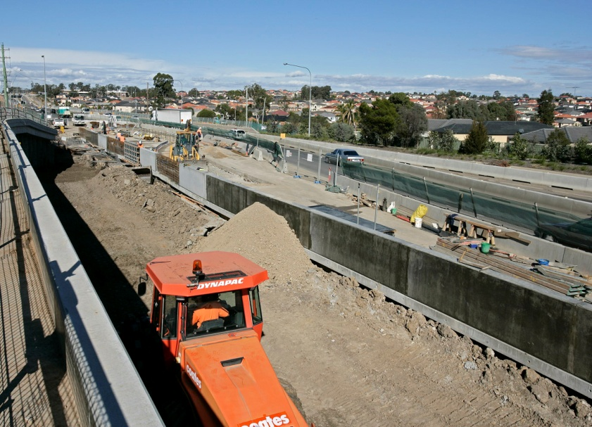
Case Study – NWT-Way, Sydney, Australia

Slide 8
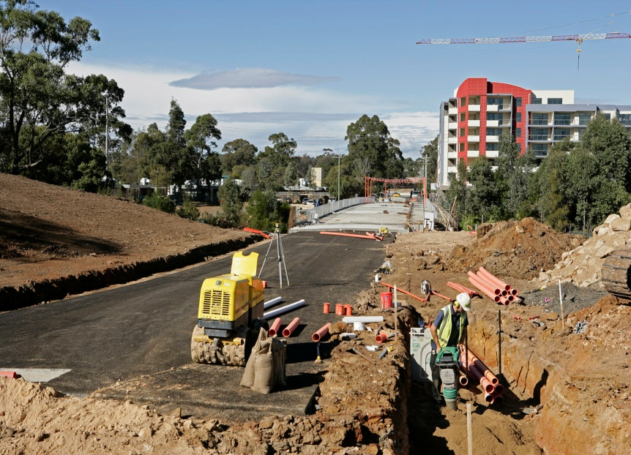
Case Study – NWT-Way, Sydney, Australia

Slide 9
1 – WBS & Work Packages
North West
T-Way
L1
Zone 1
Zone 2
Zone 3
Zone 4
L2
Section 1
Section 2
Section 3
Section 4
Section 5
Section 6
Section 7
Section 8
L3
50
Locations
(all Sections)
L4
34
Disciplines
L5

Slide 10
2 – Budget Cost Allocation
Locate the 4th or 5th level of WBS.
Get the direct cost info.
Allocate costs over each Work Package.
Allocate the linear relationship or a more accurate non-linear expenditure against time.

Slide 11
3 – Schedule & Plan Value (PV)
Prepare your schedule plan using CPM
Locate the WP’s within the schedule
Allocate the costs to WP’s
Create the S-Curve, PV or BCWS
Do resource levelling
Check the financing plan
Finalise the PV curve

Slide 12
Plan Value (PV)

Slide 13
4 – Progress Monitoring/Updating
Schedule updating Fortnightly with:
Actual Start & Finish dates
Revised Start & Finish dates
Revised Duration
Updated Incomplete activities
0-100; 50-50; 25-75; and 33-67
Level of Effort (LOE)
Percent Complete

Slide 14
4 – Progress Monitoring/Updating
Cost updating Monthly with:
Claim Costs
Site Actual Costs (AC) or ACWP

Slide 15
5 – EVPM calculation
EV(BCWP) = % Comp x PV(BCWS)
Schedule Variance (SV) = EV – PV
Cost Variance (CV) = EV – AC
SPI = EV / PV
CPI = EV / AC
PCP = PV / Total Budget
PCA = EV / Total Budget
EAC = AC + ETC

Slide 16
6 – Data Analysis & Progress Report
Summary Programme Progress Report
Critical Path Investigation
Design Progress Report
Construction Progress Report
Earned Value Progress Report
Schedule/Cost Variance Progress Report
Cash Flow Report

Slide 17
6a – Programme Progress Report
Description
Cumulative Progress
Monthly Progress
Planned
Actual*
Variance
Planned
Actual*
Variance
Zone 1:
Design Status (%) =
100%
100%
0%
0.0%
0.0%
0.0%
Construction Status (%) =
100%
100%
0%
0.0%
0.0%
0.0%
Zone 2:
Design Status (%) =
100%
100%
0%
0.0%
0.0%
0.0%
Construction Status (%) =
100%
100%
0%
0.0%
0.0%
0.0%
Zone 3:
Design Status (%) =
100%
100%
0%
0.0%
0.0%
0%
Construction Status (%) =
77.4%
86.9%
9.5%
3.9%
3.5%
0.4%
Zone 4:
Design Status (%) =
100%
100%
0%
0.0%
0.0%
0.0%
Construction Status (%) =
67.2%
70.1%
2.9%
9.3%
7.1%
2.2%
TOTAL:
Design Status (%) =
100%
100%
0%
0.0%
0.0%
0.0%
Construction Status (%) =
85.7%
88.7%
3.0%
3.5%
2.8%
0.7%
TOTAL Project Status (%) =
86.8%
89.5%
2.7%
3.1%
2.6%
0.5%

Slide 18
6b – Critical Path Investigation

Slide 19
6c – Design Progress Report

Slide 20
6d – Construction Progress Report

Slide 21
6e – Earned Value Progress Report

Slide 22
6f – S/C Variance Progress Report

Slide 23
6g – Cash Flow Report

Slide 24
Conclusion
EVPM is a good tool for improving the analysis of progress and performance on a construction project.
Although level 4th WP’s give accurate results, site engineers feel more confident at 5th level.
General overheads and profits should be eliminated from the analysis so that actual expenditure can be directly compared with budgeted expenditure.
Within this closed network, activities are updated with time data and WP’s updated with cost info.
The test data needs to be expanded with data from a wider range of road projects to provide more practical usages and procedures of EVPM system.
Getting the accurate cost figures from financial dept and the real time and performance data from site engineers, makes the EVPM system a reliable performance measurement tool.

Slide 25
Acknowledgment
Consulting services was undertaken and fully supported by:
Blue Visions Management Pty Ltd (BVM), Sydney, Australia.
Database support has been provided by:
Leighton Contractors Pty Ltd (LCPL), Australia.

Slide 26
THANK YOU

